Slide 1
Data Visualization Challenge
December 4, 2020
Jesse Rowles

Slide 2
Overview
Daily Time Series with Events Highlighted
Pie Chart of Total Volume Used
With Irrigation
Without Irrigation
Stacked Bar Chart for Hour of Day
Stacked Bar Chart for Day
Stacked Bar Chart of Proportion of Type by Day
Efficiency Improvements Based on Water-Limiting Behaviors
Compare Building To Nearby/Similar Buildings
Histogram Comparisons to Nearby Homes
Trend Projections

Slide 3
Notes
All event types are color-coded throughout (e.g., pink is always irrigation, green is always hose, etc.)

Slide 4
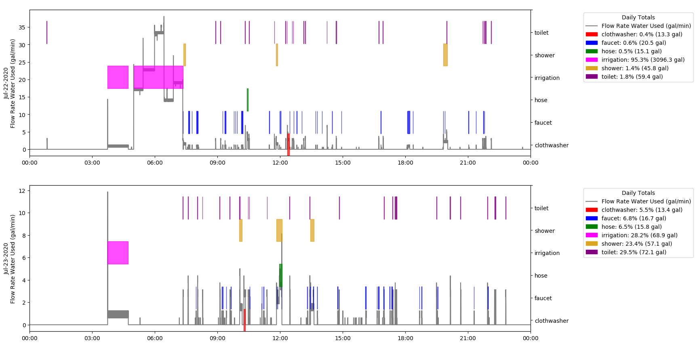
Daily Time Series with Events Highlighted
Colored polygons show when event occurs and correspond with y-axis on right of plot
Y-value only indicates type, no other volume or flow meaning
Black line is time series of water used (in gallons) and corresponds with left y-axis
Legend shows volume of water used for each type of event as well as proportion of event in daily totals
Intended to show frequency of events, as well as how durations compare graphically

Slide 5
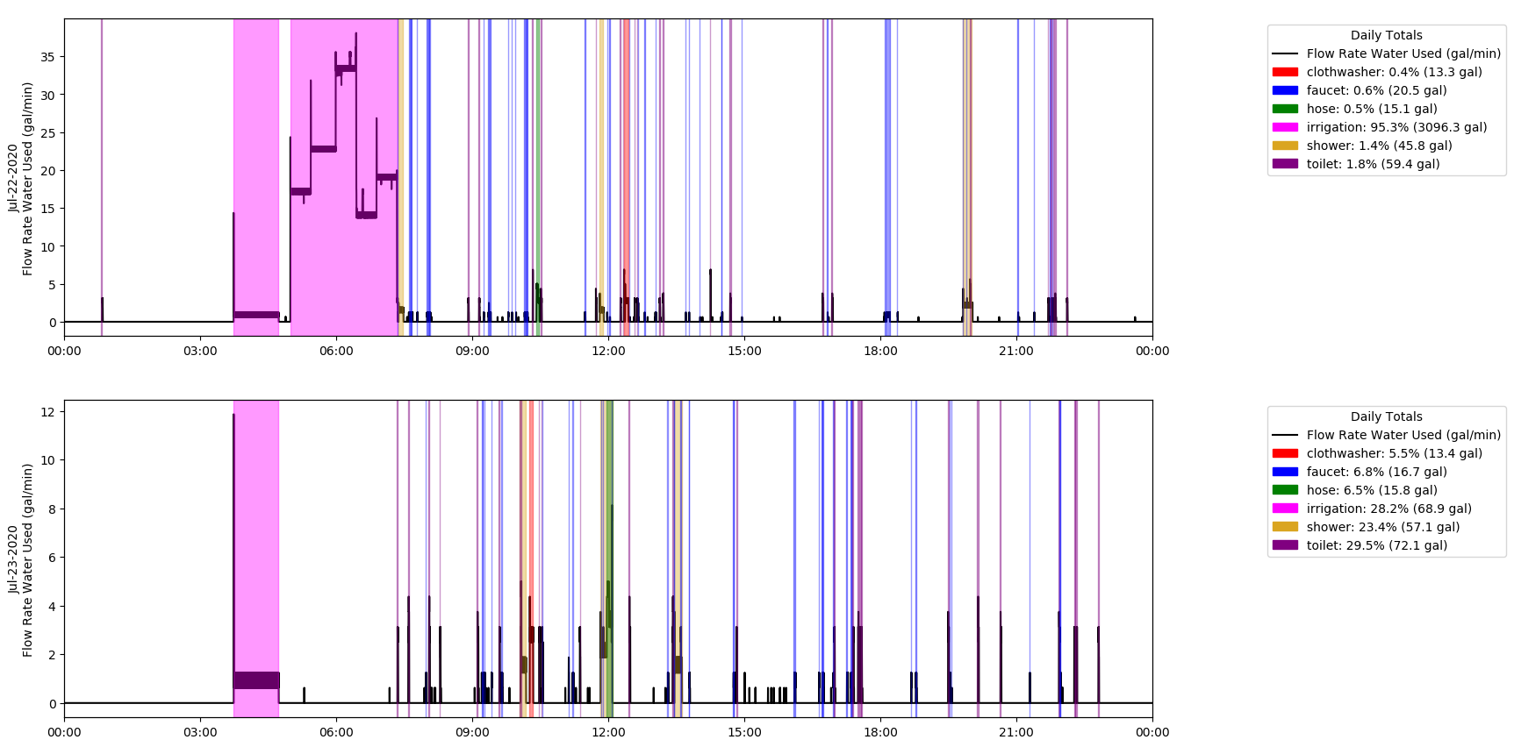
Daily Time Series with Events Highlighted Variant
May be more visually appealing in some ways, but I find it difficult to read when there are multiple events occurring at the same time, especially when the events last such a short amount of time

Slide 6
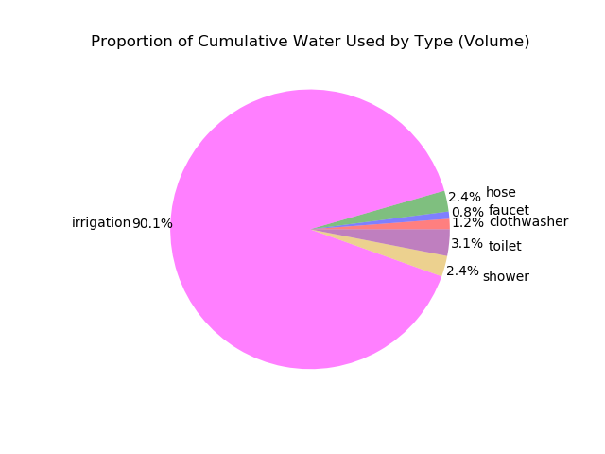
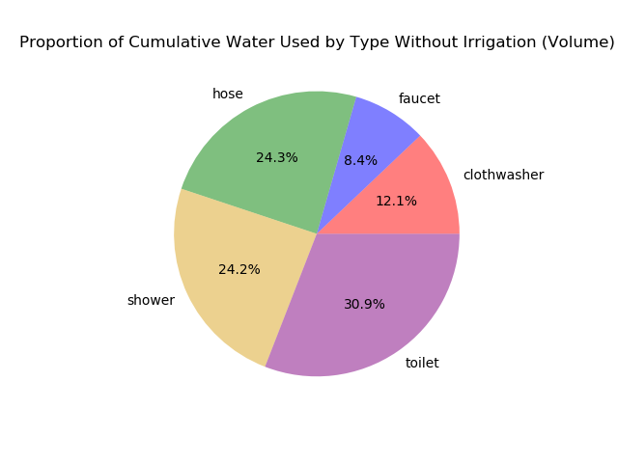
Pie Chart of Total Volume Used
Notes:
cumulative

Slide 7
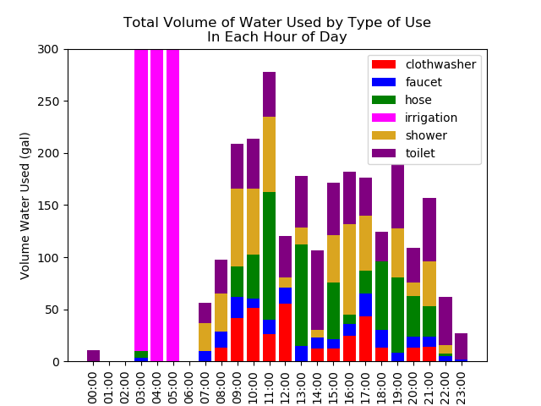
Stacked Bar Chart for Hour of Day
Shows sum of all water used for each event type in each hour of day over period of record
Irrigation amounts make other data unreadable so y-axis limited to see other types
~1000 gal at 03:00, ~20,000 gal at 04:00, 9000 gal at 05:00
Intended to show times of most water use
Where water is going
When high-volume times are to limit water use
Draw attention to unexpected trends in time of day (e.g., if nobody is home from 9-4 but water use is high – why?)
Suggest when activities could be moved around (e.g., using hose outside period of day when evaporation is high like 11a-12p)
Notes:
Hose at 11 – highest evaporation during day, could I move things around to be more efficient?

Slide 8
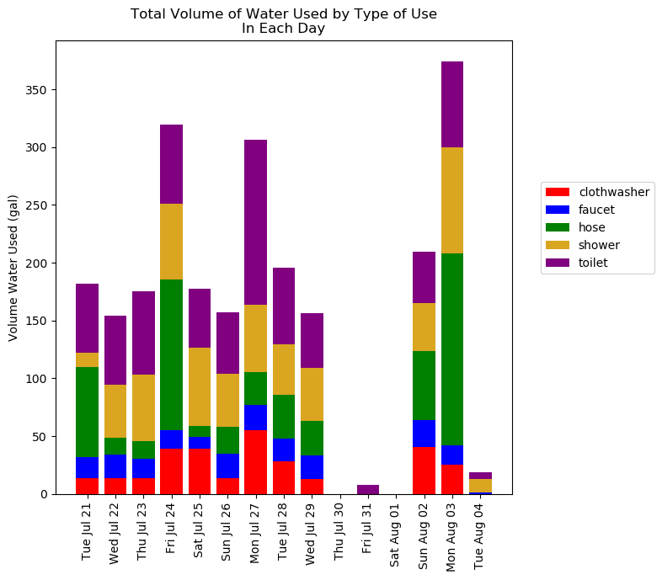
Stacked Bar Chart for Day
Stacked bar chart to indicate days of high-use and by how much
Irrigation removed due to overpowering of ability to visualize data
Useful in showing trends throughout seasons or weeks of year to show when the most water is being used in time of year
Day of week indicates water used on weekday vs weekend
Would also be useful as week or month of year instead of day to show trends throughout year
Notes:
Add day of week to title

Slide 9
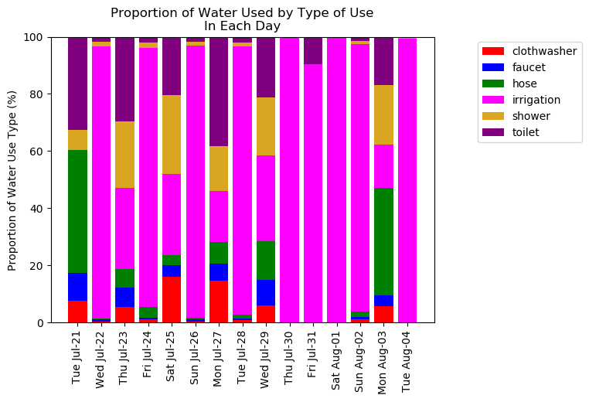
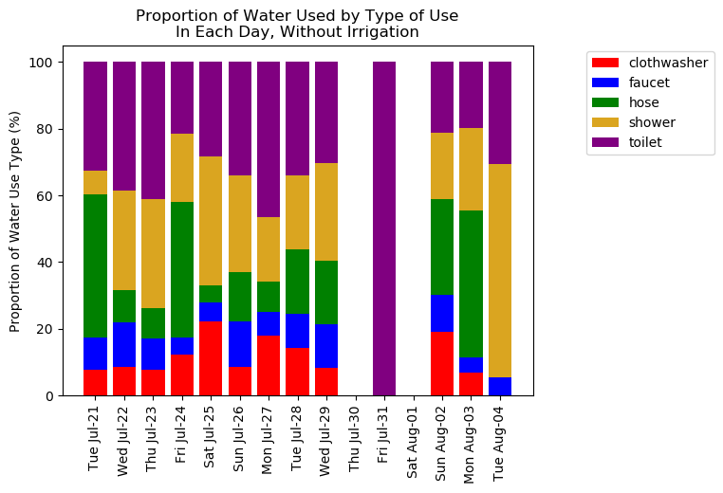
Stacked Bar Chart of Proportion of Type by Day
All Types Without Irrigation
Notes:
Day of Week

Slide 10
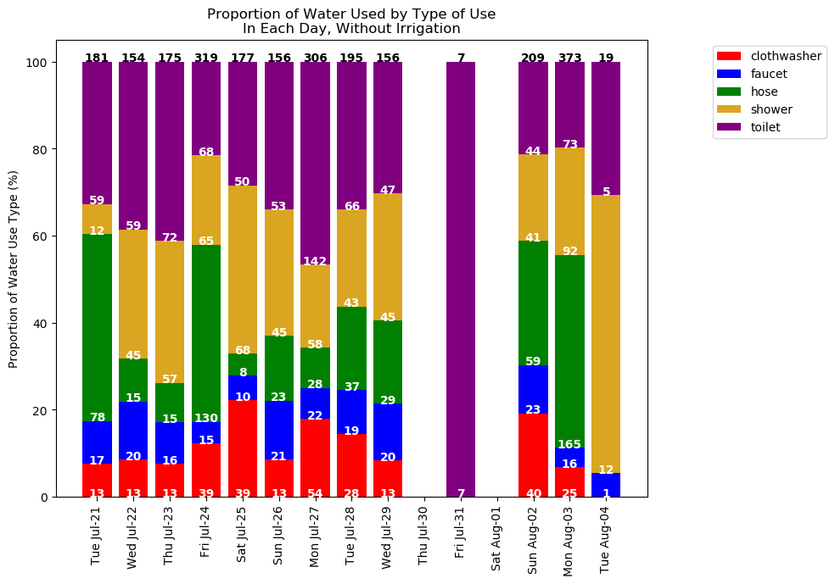
Stacked Bar Chart of Proportion of Type by Day - Variant
Can add volumes of each type and total to indicate both proportion of total water used as well as volume
Helps to show days when little or a lot of water are used while showing breakdown (e.g., Jul 31)
Could be misleading, so needs to be made clear that numbers are not percentages, but volumes (although could easily show %s instead)
May be difficult in days to view numbers with irrigation dominating
Days of week shown to show changes between weekdays/end

Slide 11
Efficiency Improvements Based on Water-Limiting Behaviors - Overview
Suggested behaviors to limit volume of water used (examples, not meant to be realistic or doable)
Limit shower durations to 10 minutes
Replace shower heads with low-flow heads at a maximum of 1.5 gpm (duration of showers unchanged)
Replaced toilets with low-flow/water-efficient toilets that use a maximum of 1.3 gal per flush
Replace faucet heads with more efficient water heads, reducing each faucet use to 75% original flow rate
Average flow rate of faucet events was 2.2 gpm
High-efficiency faucet heads can operate at a maximum of 1.6 gpm
1.6 gpm / 2.2 gpm = 75%
All above improvements implemented

Slide 12
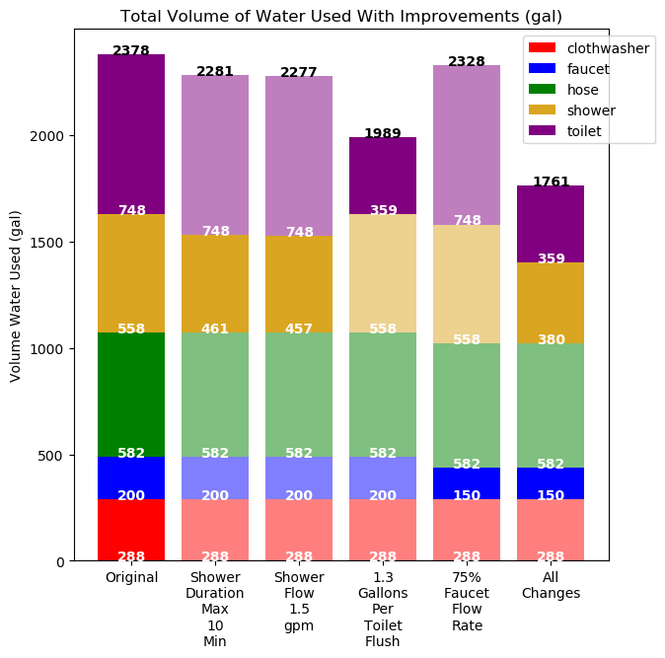
Efficiency Improvements Based on Water-Limiting Behaviors – Volume Plot
Total volume water use displayed on top of bar in black
Volume of individual use types shown at bottom of section in white
Irrigation not included, but if improvements can be made to irrigation, would be good to add
Colors of bar section are bold if value changes from original, otherwise slightly transparent
Shows reduction in each individual use as well as total with different water-saving behaviors in effect
Can be used to determine money saved or highlight measures with largest impact

Slide 13
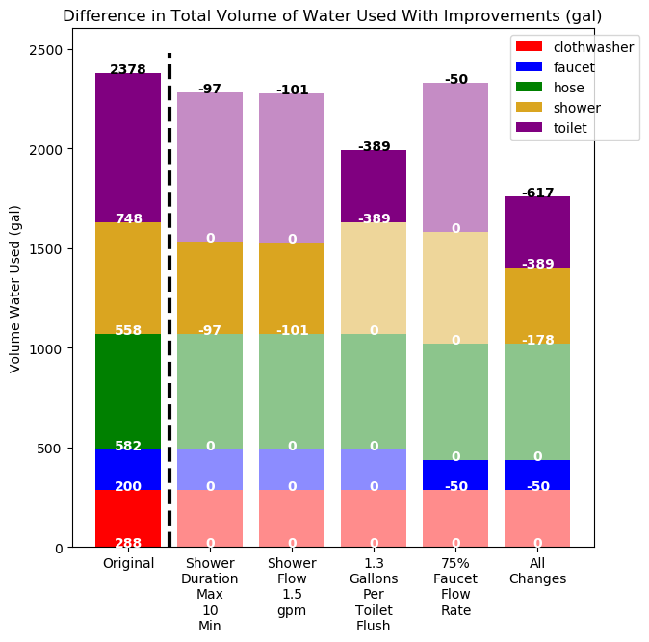
Efficiency Improvements Based on Water-Limiting Behaviors – Difference Plot
‘Original’ column shows water volume used for each type and total
Other columns show change in volume from original for each type and total with improvement implemented
Dashed line indicates showing total volume vs difference in volume in all other bars besides original
Alternative to previous plot to show change in volume possible from different improvement measures
Something similar could be done for irrigation, but I’m not sure on improvement techniques since irrigation is volume based (depth in soil times area of land)
Adjusting time of day to decrease evapotranspiration (if possible)
Could also be done as percent reduction of original, but I thought number of gallons would be more useful to home owner to determine savings in water use
e.g., 617 gallons less than original / 2378 gallons in original = 26% less than original
Notes:
Dim all ones that don’t changes

Slide 14
Compare Building To Nearby/Similar Buildings
Percentiles of water efficiency – how building of interest compares to others (e.g., “your home is in the 80th percentile of faucet usage in homes in a 50-miles radius”)
Show how building of interest compares to nearby buildings
Provoke interest in home/building owner to ask around and see what practices others are using

Slide 15
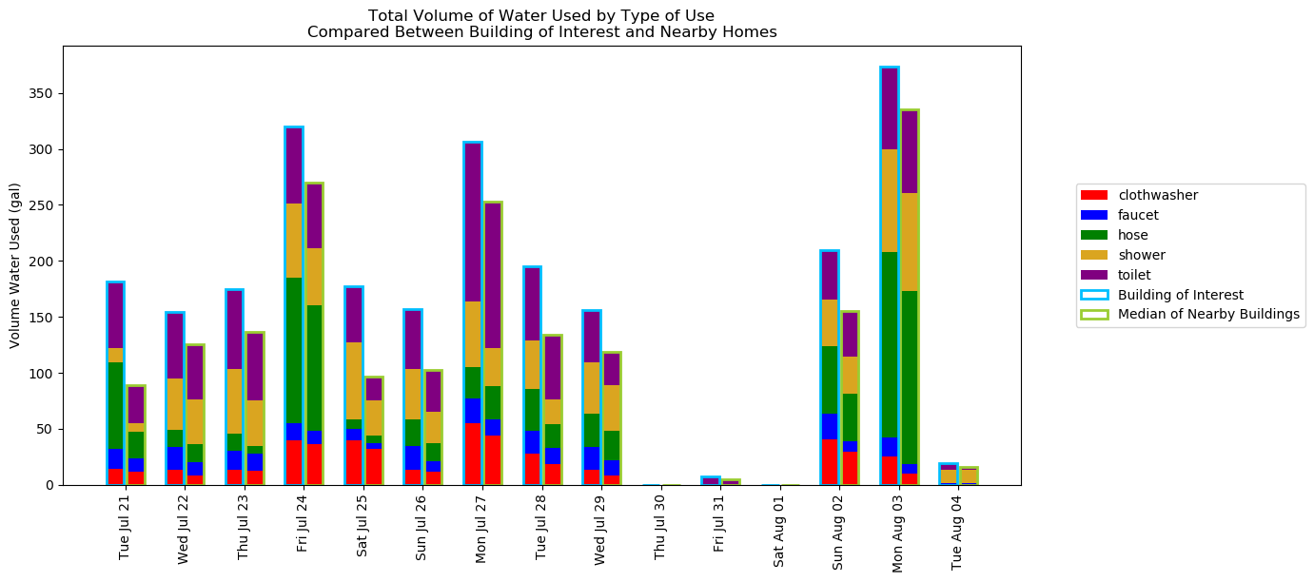
Compare Building To Nearby/Similar Buildings Example Overview
Shows building of interest outlined in cyan against median of all other buildings nearby (within radius?)
‘Median’ data created by multiplying given data by random decimal for visualization purposes
This example shows the home of interest using more water than most of the nearby homes

Slide 16
Compare Building To Nearby/Similar Buildings Potential Enhancements
Could divide water use
Divide each type by number of people in residence for per person usage
Divide by land area to get water use per acre
Could show on any timescale presented in this work (e.g., hour of day, monthly, total over any period)
Could show building of interest against any percentile (including min or max) of nearby buildings
Recommend classifying nearby buildings similarly to one of interest (e.g., compare home to nearby homes, industrial to nearby industrial, etc.)

Slide 17
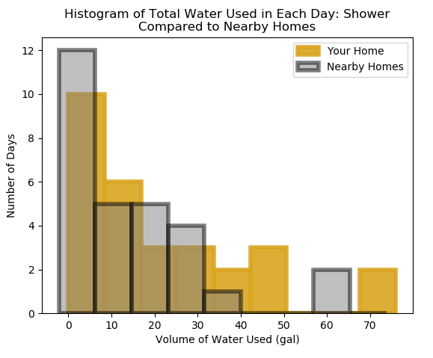
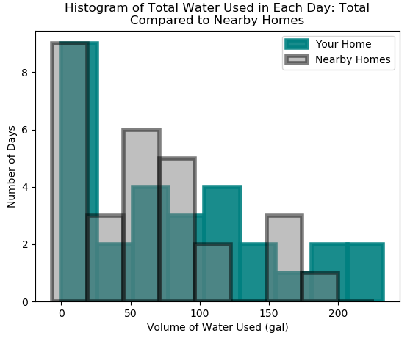
Histogram Comparisons to Nearby Homes
Histograms of 12-hour totals of volume of water used in home of interest and nearby homes for each type and total
Total here shown without irrigation since it causes bimodal distribution
Would be improved with more days to get more full distribution (15 days in record, n = 29)
Another method of comparison to indicate days of higher water use than surrounding homes
Individual plots for each type could indicate problem use areas (e.g., if shower histogram has many bars higher than surrounding areas, but all others don’t)
Could show if one volume range has many more than others and cause homeowner to consider why
Histogram may be advanced concept for average homeowner

Slide 18
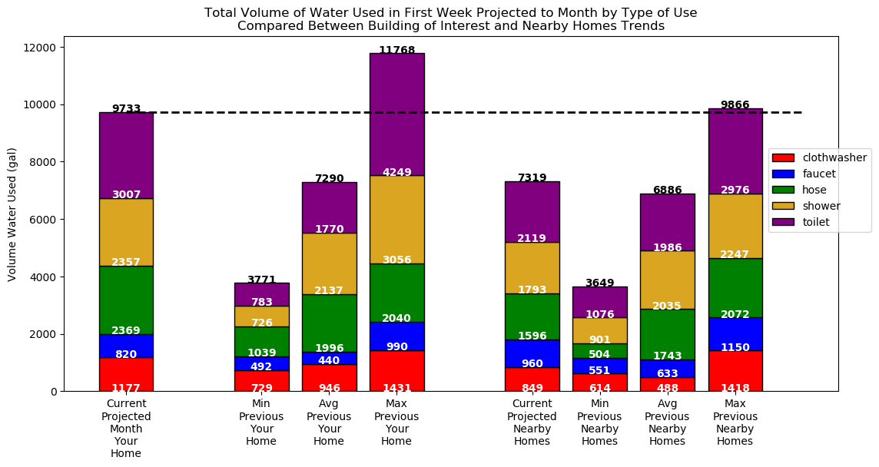
Trend Projections
Projecting water use to a longer time scale (e.g., projecting first week of month to monthly scale)
Compare longer time scale
To previous minimum, maximum, median of building of interest
To other nearby buildings’ minimum, maximum, median, average, etc.
Alerts homeowners to use trends to keep end use down in future

